Slide 1
Project Title
EMAIL CAMPAIGN EFFECTIVENESS PREDICTION (CLASSIFICATION) Team Members Vishal Singh(142302009) Santanu Pal(142302016) Ratnesh Verma(142302017)

Slide 2
Problems statements
Most of the small to medium business owners are making effective use of Gmail-based Email marketing Strategies for offline targeting of converting their prospective customers into leads so that they stay with them in business. The main objective is to create a machine learning model to characterize the mail and track the mail that is ignored; read; acknowledged by the reader. Data columns are self-explanatory.
Class 0 implies Email is ignored by the reader
Class 1 implies Email is Read
Class 2 implies Email is Acknowledged by Reader

Slide 3
Data Summary
The number of rows in data is: 68353 and the number of columns in data is 12
Data Summary
Categorical_data
Email Id
Email type
Email source type
Customer location
Email campaign type
Time email sent category
Email status(Target variable)
Continous data
Word count
Subject hotness score
Total links
Total images
Total past communication

Slide 4
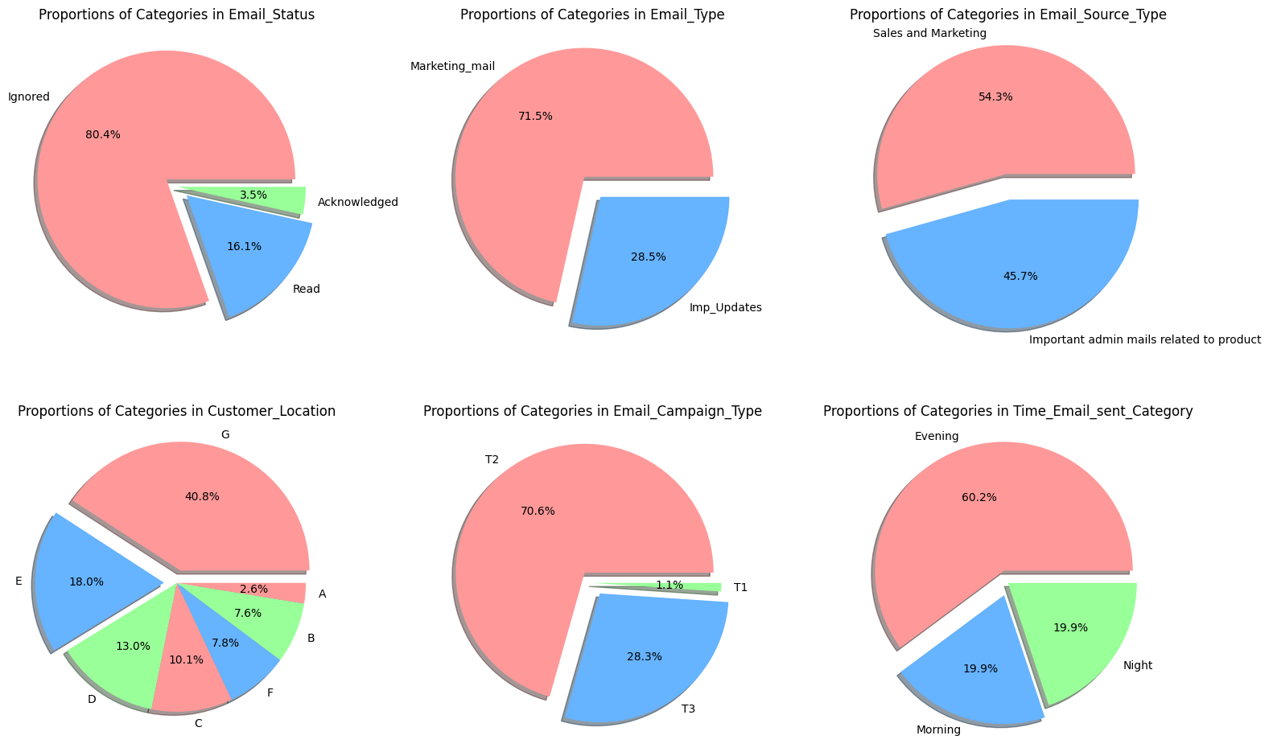
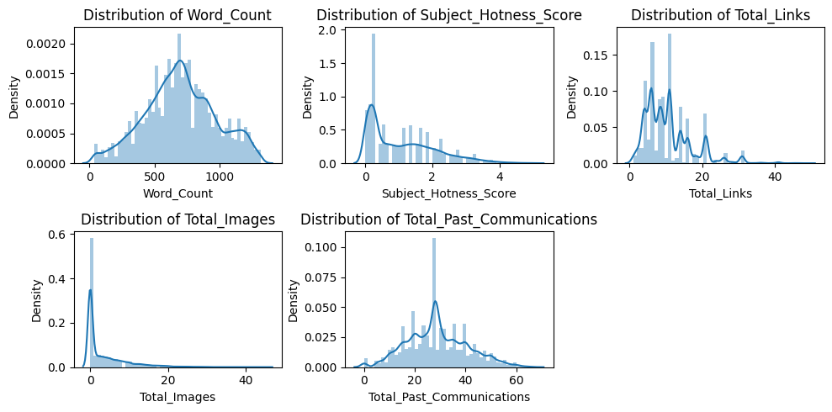
Data Visualization
Pie Chart for Categorical data (Univariate) and distribution graph

Slide 5
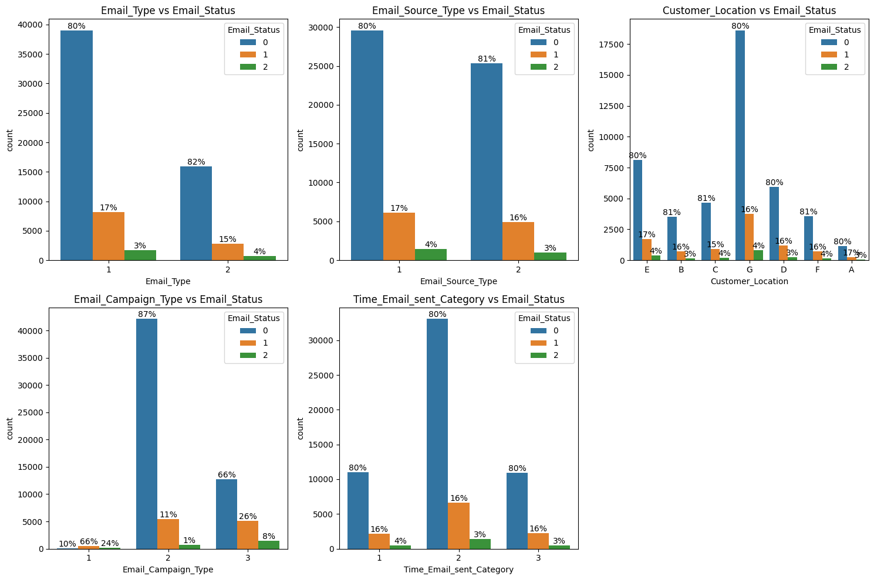
Bar plot for categorical data(Bivariate)

Slide 6
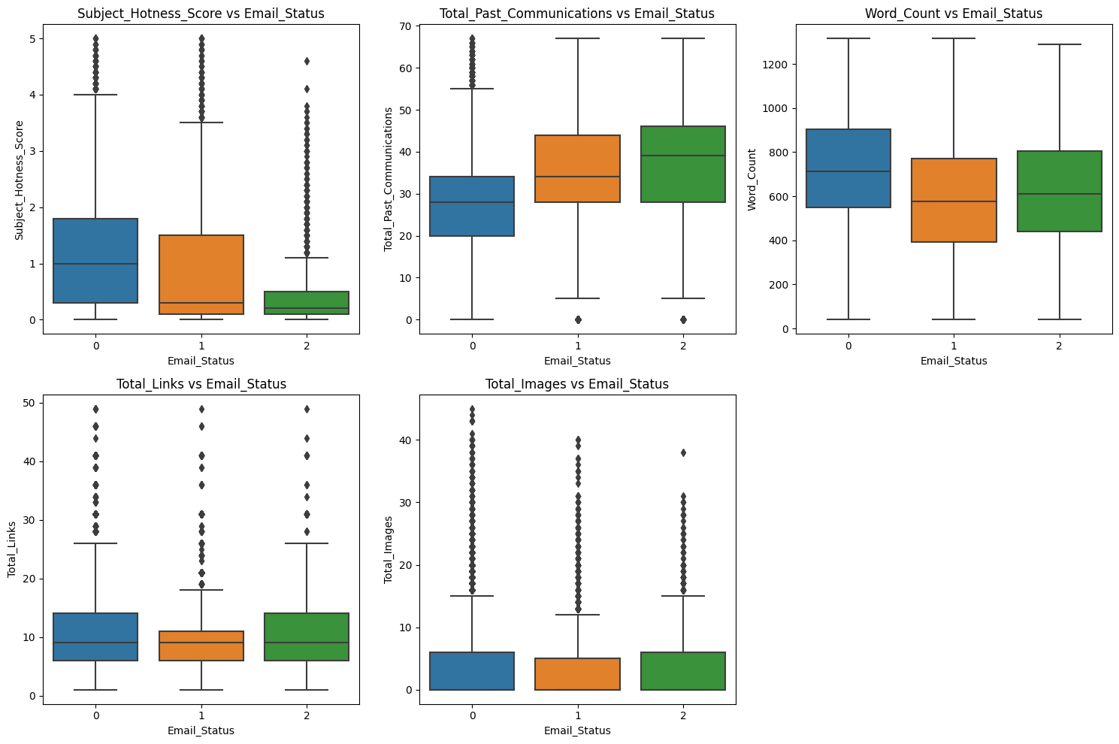
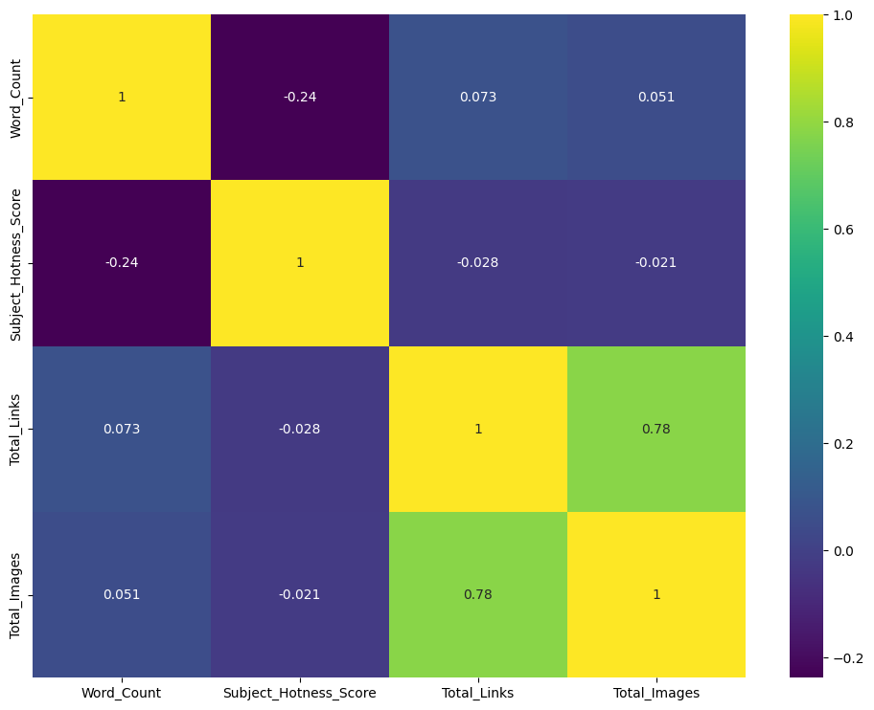
Box plot for continuous data to show outliers(Bivariate) and Heatmap
Except Word count all other features has outliers which needs to be removed
Here we can see that Total links and Total images are highly correlated , hence we can either merge them in one column or can delete one of the column.

Slide 7
Feature Engineering and Data Preprocessing
Features having missing values
Customer location: 11595 (16.97%)
Total past communication: 6825 (9.98%)
Total links: 2201 (3.2%)
Total images: 1677 (2.45%)
Handling Missing Values
Droping the customer location column
In Total past communication null values replaced by Median
In Total links null values replaced by Median
In Total images communication null values replaced by Mode
Combine 'Total_Images' and 'Total_Links' into a new column 'Total_Img_links

Slide 8
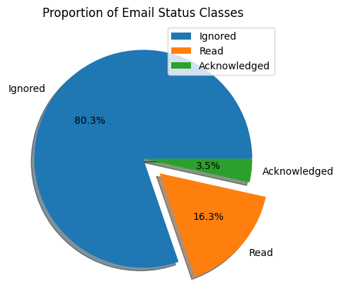
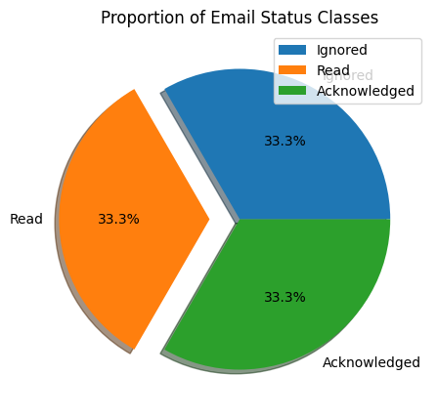
Data scaling
Used Standardization( Z-score )
Data splitting
Test data: 20%
Train data: 80%
Handling Class Imbalance:
SMOTE

Slide 9
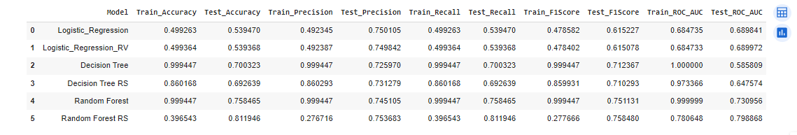
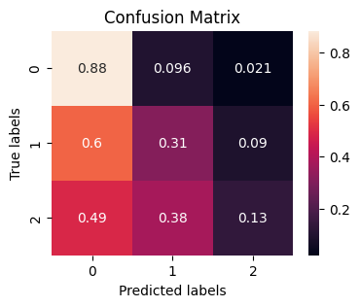
Model Implementation
We are choosing Random Forest because its F1 score is highest among all the models

Slide 10
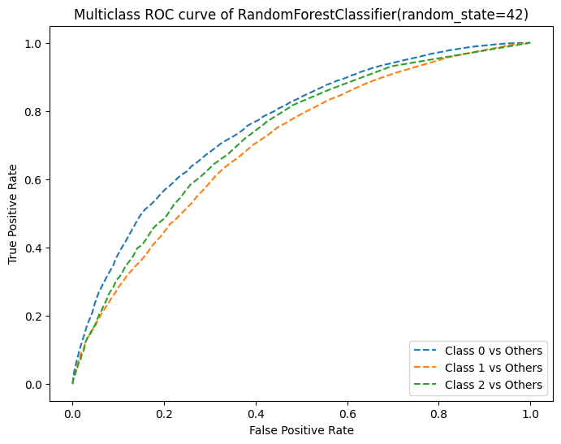
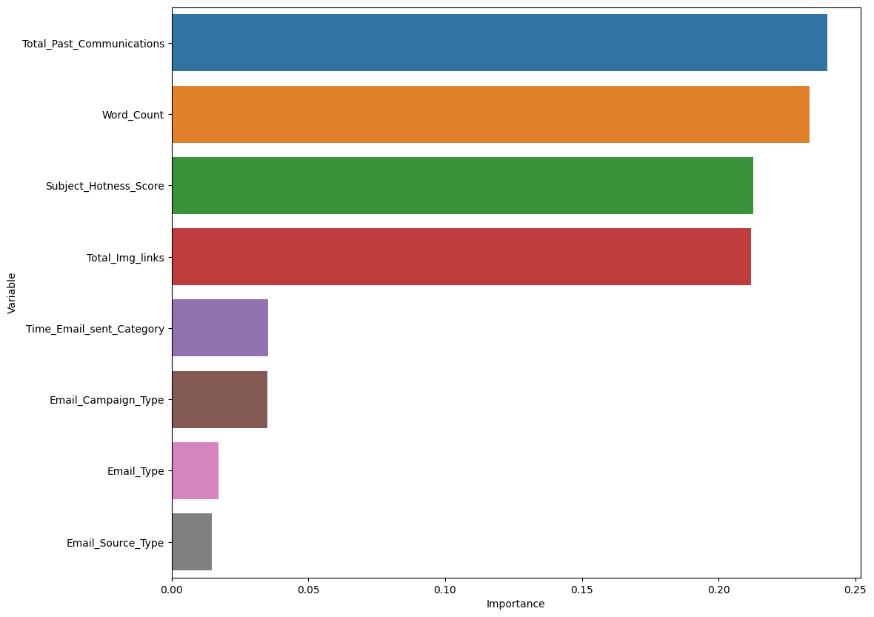
Feature importance

Slide 11
Conclusion
Customer location doesn't significantly impact email responses (ignored, read, acknowledged).
Campaign type 1 had fewer emails but a high likelihood of being read. Campaign type 2 saw the most emails, with most being ignored. Campaign 3 had fewer emails but more reads and acknowledgments.
Time email sent isn't a strong factor; emails sent in the middle of the day tend to be read and acknowledged more.
More past communications lead to increased reads and acknowledgments, showing a customer connection trend.
Longer emails tend to get ignored more frequently.
Ignored emails contain more images.
Outliers exist in most continuous variables and we removed both majority and minority class.

Slide 12
Recommendations based on analysis:
1. Email Content: Maintain a reasonable word count, ensuring concise and impactful content without excessive marketing gimmicks.
2. Email Campaigns: Continuing Campaign 1 appears wiser given its higher success rate compared to other campaigns, suggesting discontinuation of the less successful campaigns. 3. Multimedia Usage: Control the number of images and links in emails to avoid overwhelming recipients. 4. Customer Interaction: maintain a healthy customer relationship as a higher number of past communications positively influenced email responses.
Thank YOU

